Slide 1
Practical Statistics for Data science Review

Slide 2
Chapter 7
Unsupervised learning

Slide 3
Introduction
Unsupervised learning refers to statistical methods that extract meaning from data without training a model on labeled data.
Dimensionality reduction (Principal Components Analysis)
Clustering (K-Means, Hierarchical Clustering, Gaussian Mixtures)
“Can be viewed as an extension of the EDA to situations where you are confronted with a large number of variables and records.”
In prediction Unsupervised learning can play an important role:
Pre-label data and transform the problem into a classification problem.
Tool against cold start.
Reduce the feature space of a predictive model.

Slide 4
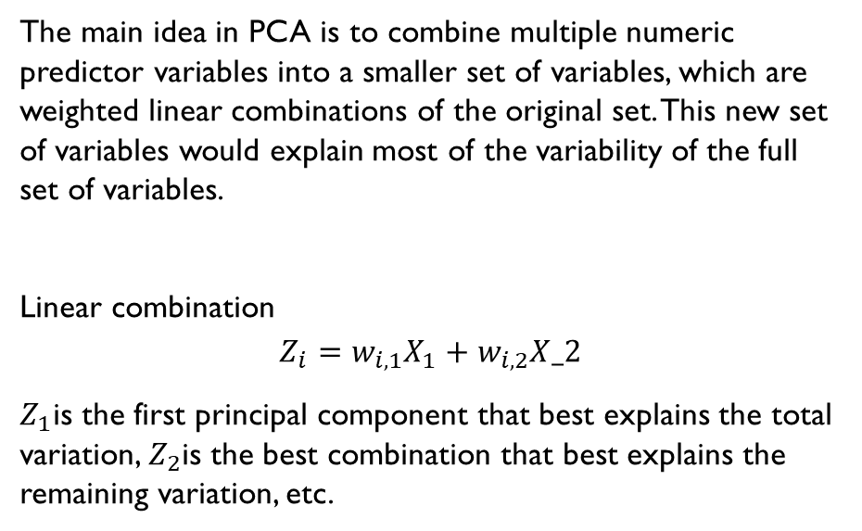
Principal Components Analysis
The main idea in PCA is to combine multiple numeric predictor variables into a smaller set of variables, which are weighted linear combinations of the original set. This new set of variables would explain most of the variability of the full set of variables.
Linear combination
$$Z_{i}=w_{i,1}X_{1}+w_{i,2}X_2$$
$Z_{1}$is the first principal component that best explains the total variation, $Z_{2}$is the best combination that best explains the remaining variation, etc.
https://medium.datadriveninvestor.com/principal-components-analysis-pca-71cc9d43d9fb

Slide 5
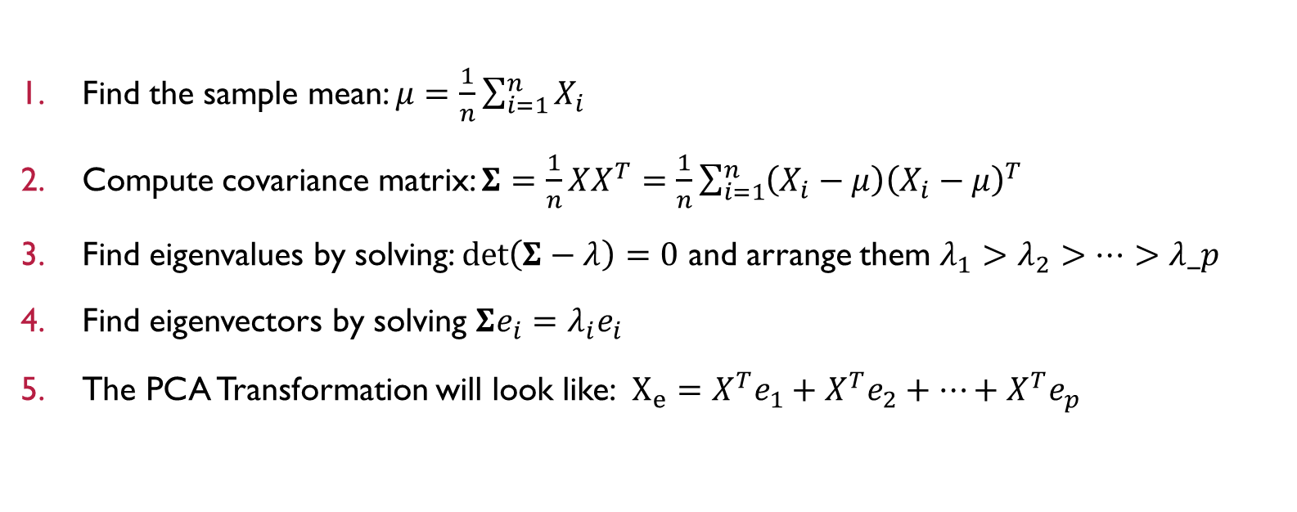
PCA Mathematical method *
Find the sample mean: $μ=\frac{1}{n}\sum_{i=1}^{n}{X_{i}}$
Compute covariance matrix: $Σ=\frac{1}{n}XX^{T}=\frac{1}{n}\sum_{i=1}^{n}{\left(X_{i}−μ\right){\left(X_{i}−μ\right)}^{T}}$
Find eigenvalues by solving: $\det\left(Σ−λ\right)=0$ and arrange them $λ_{1}>λ_{2}>…>λ_p$
Find eigenvectors by solving $Σe_{i}=λ_{i}e_{i}$
The PCA Transformation will look like: $X_{e}={X^{T}e}_{1}+{X^{T}e}_{2}+…+{X^{T}e}_{p}$
PC1
PC2
PCp

Slide 6
PCA Summary
Principal components are linear combination of the predictor variables.
They are calculated to minimize correlation between components, reducing redundancy.
A limited number of components will typically explain most of the variance in the outcome variable.
The limited set of principal components can then be used in place of the original predictors, reducing dimensionality.

Slide 7
K-Means Clustering
Clustering is a technique to divide data into different groups, where the records in each group are similar to one another.
K-means divides de data into K clusters by minimizing the sum of the squared distances of each record to the mean of its assigned cluster.
Cluster:
A group of records that are similar.
Cluster mean:
The vector of variable mean for the records in a cluster.
K:
The number of clusters.

Slide 8
K-means algorithm
The algorithm starts with a user-specified K and an initial set of cluster means.
Assign each record to the nearest cluster mean as measured by squared distance.
Compute the new cluster means based on the assignment of records.
The algorithm isn’t guaranteed to find the best possible solution due random initialization. Thus, running several times is recommended and retrieved the iteration that as the lowest within cluster sum.

Slide 9
K-Means Summary
The number desired of clusters K is chosen by the user.
The algorithm develops clusters by iteratively assigning records to the nearest cluster mean until cluster assignments do not change.
Practical considerations usually dominate the choice of K; there is no statically determined optimal number of clusters.

Slide 10
Hierarchical clustering
Benefits
disadvantage
More flexible than K-means.
Handles better non-numeric variables.
Sensitive to outlying groups.
Intuitive graphical display (Dendrogram).
Does not scale well to large datasets.
High computational cost for modes-sized data.

Slide 11
The Dendrogram
Hierarchical clustering leans itself to a natural graphical display as a tree.
The leaves of the tree correspond to the records. The length of the ranch indicate the degree of dissimilarity between corresponding clusters.

Slide 12
The agglomerative algorithm

